Slide 1
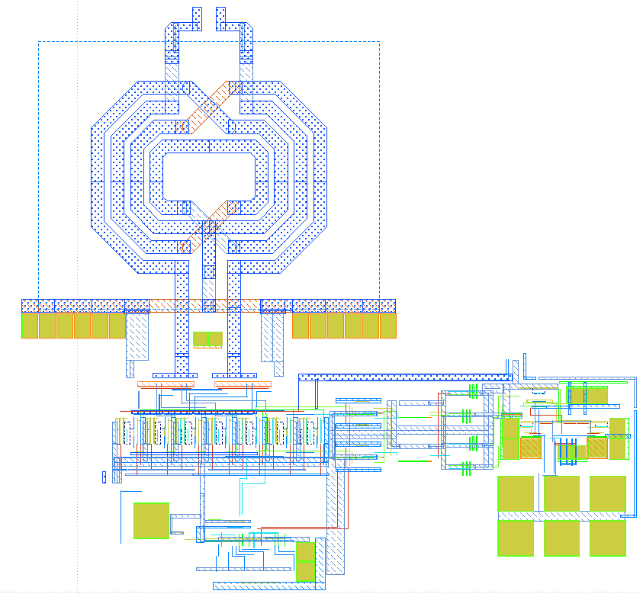
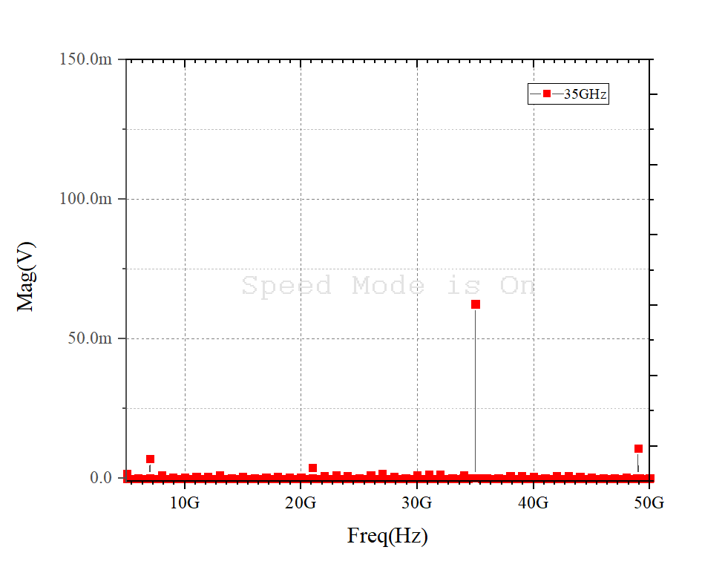

Design of 35 GHz Sub-Harmonically Injection Locked Multiplying Delay Lock Loop Using 65-nm CMOS Technology
Dong Yeol Yang, Jae Hyun Park and Byung-Sung Kim
RF Microelectronic Design Lab., Sungkyunkwan University, Suwon 440-746, Korea
Abstract
We propose a 35 GHz Multiplying Delay Lock Loop used injection lock to reduce phase noise of ring oscillator in 65-nm CMOS process. The MDLL include ring oscillator, delay cell(with injection), and PFD, Charge pump, Loop Filter, Adder and frequency of reference clock is 1GHz. The MDLL achieves 50ns lock time and consumes 11mW , 32 dBc
I. Introduction
Low-jitter clock generation is becoming increasingly
more important as electronic devices try to achieve higher performance. Ring-oscillator-based clock generation are especially of much interest, as they require small silicon area compared with LC oscillator counterpart.
Unfortunately, achieving a low-jitter clock from a ring oscillator is difficult due to the lack of high-Q components.
In this paper, We propose 35 GHz Multi Phase Delay Lock Loop which used sub-harmonically injection lock to reduce phase noise of ring oscillator with 65-nm CMOS process.
II. Description
The proposed MDLL consist of ring oscillator, delay cell(with injection), and PFD, Charge pump, Loop Filter, Adder.
The output of ring oscillator and delay cell(with injection) is compared in PFD. The output determines control voltage(up or down). then bias cell controls bias voltage in delay cells.
This architecture has advantage of reducing phase noise of ring oscillator because the phase noise follows injected signal.
III. Simulation Results
Fig. 2 show the chip photograph of MDLL. The overall chip size is 570 um * 520 um.
Fig. 3 shows simulation result. MDLL output shows -11dbm at 35GHz.
Fig. 2. Chip photograph
v
Bias cell
Adder + Transformer
35GHz
v
v
v
Delay cell
PFD
Charge Pump
Loop Filter
x1
x2
x3
x4
x5
v
Delay cell
with injection
v
v
v
Delay cell
with injection
1GHz Injection
Delay cell
Fig. 1. Schematic of receiver
Fig. 3. DFT of output of Transformer(50Ω matched)
IV. CONCLUSION
This paper demonstrated 35 GHz Multiplying Delay Lock Loop used injection lock to reduce phase noise of ring oscillator using Samsung 65-nm CMOS. The MDLL occupies 570 um * 520 um. The output power is -11dbm at 35GHz.
Acknowledgement
The chip fabrication and EDA tool were supported by the IC Design Education Center(IDEC), Korea.
This material is based upon work supported by the Ministry of Trade, Industry & Energy(MOTIE, Korea) under Development Program of Next-Generation Intelligent Semiconductor Technology (Design and Manufacturing). No.20009868, Development of 120GHz light-weight low-power Radar SoC for OMS(Occupancy Monitoring System).

